Slide 1

Big Mountain Ski Resort
Presentation by Anthony Medina

Slide 2
How much should Big Mountain Resort raise their ticket prices?
Things to keep in mind. . .
We need to recoup the 1.5 million dollar expense of our new chair lift
We need to keep profit margins within 8%
The new ticket price needs to be competitive
We need to explore additional cost saving strategies and pick the best one
This needs to be finished before the opening of the next season
We’ll do it with DATA!

Slide 3
The data recommends that the new ticket price is
$95.87
The data also recommends that we close 5 of the currently open runs without compromising the longest, and without losing any vertical drop.

Slide 4
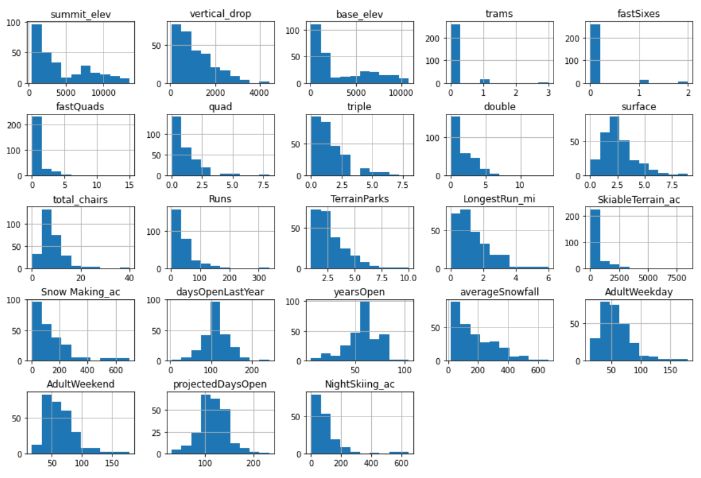
Initial look at the distribution of features
After removing some bad data and rows that had some missing data, this is what the distribution of figures looked like.

Slide 5
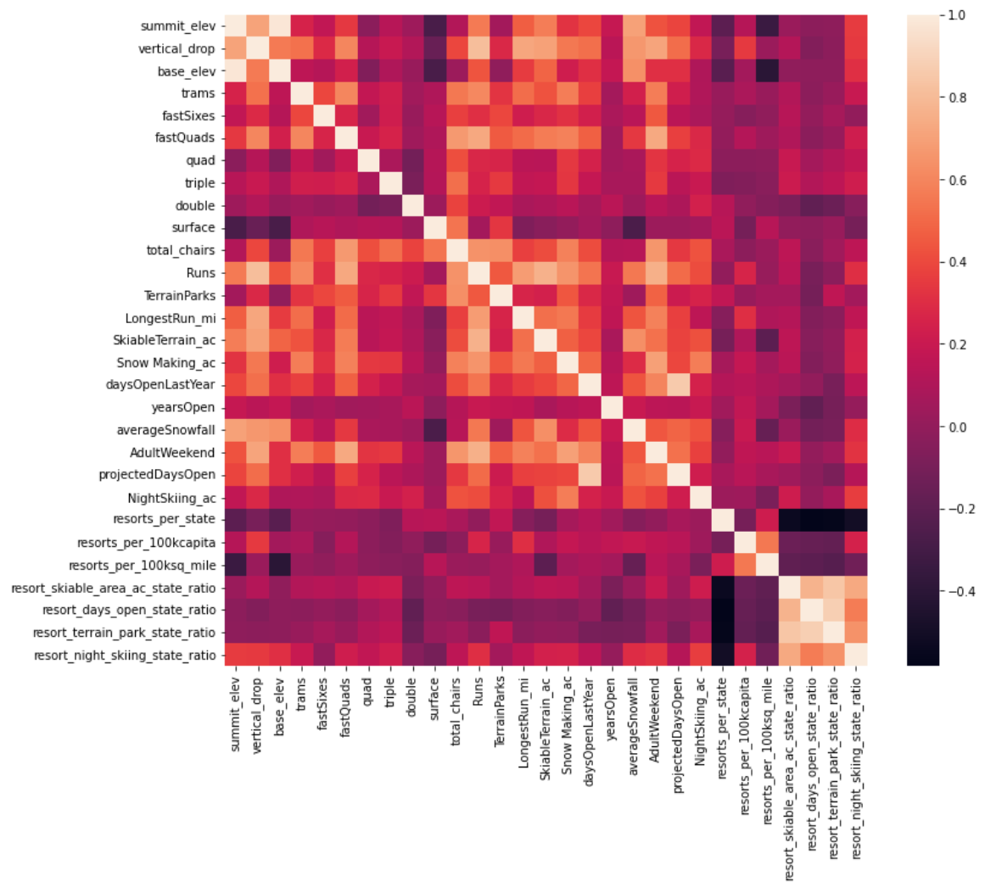
Heatmap of feature influence on ticket price

Slide 6
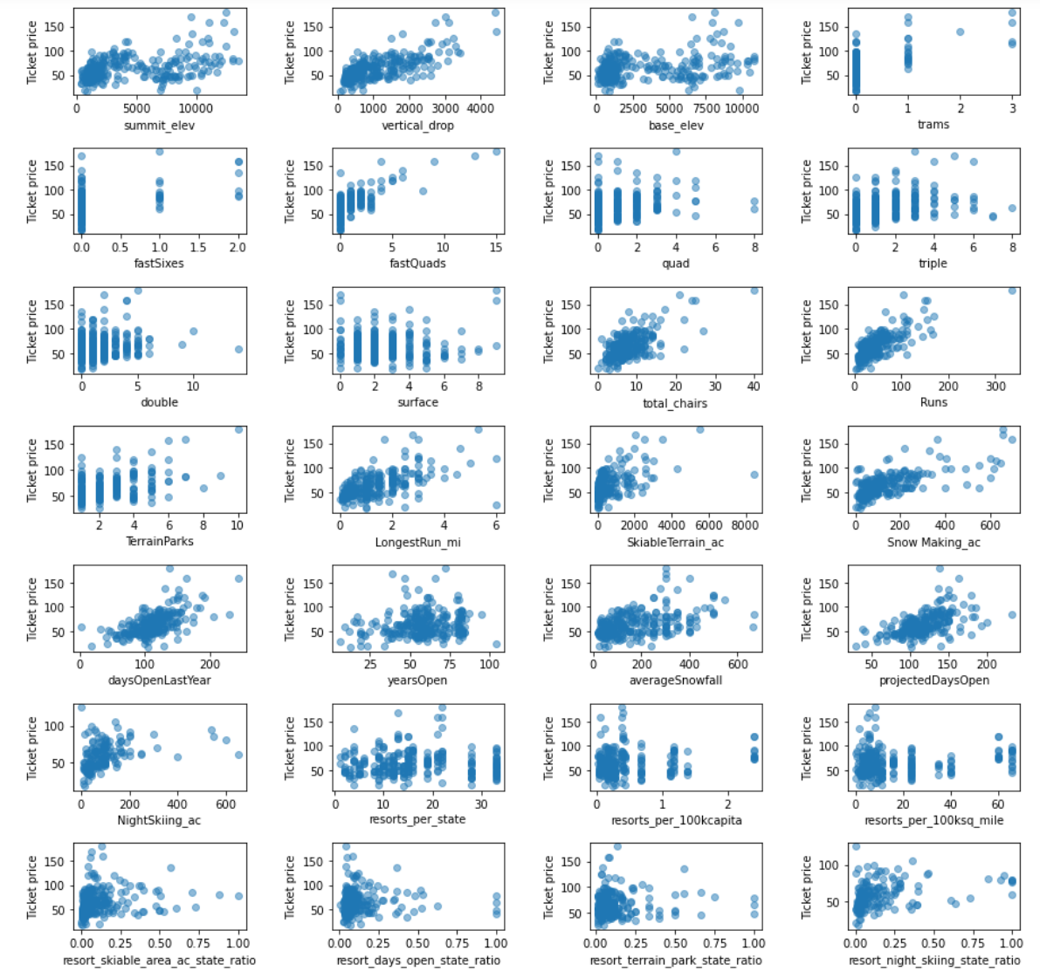
Scatterplot of ticket prices vs features.

Slide 7
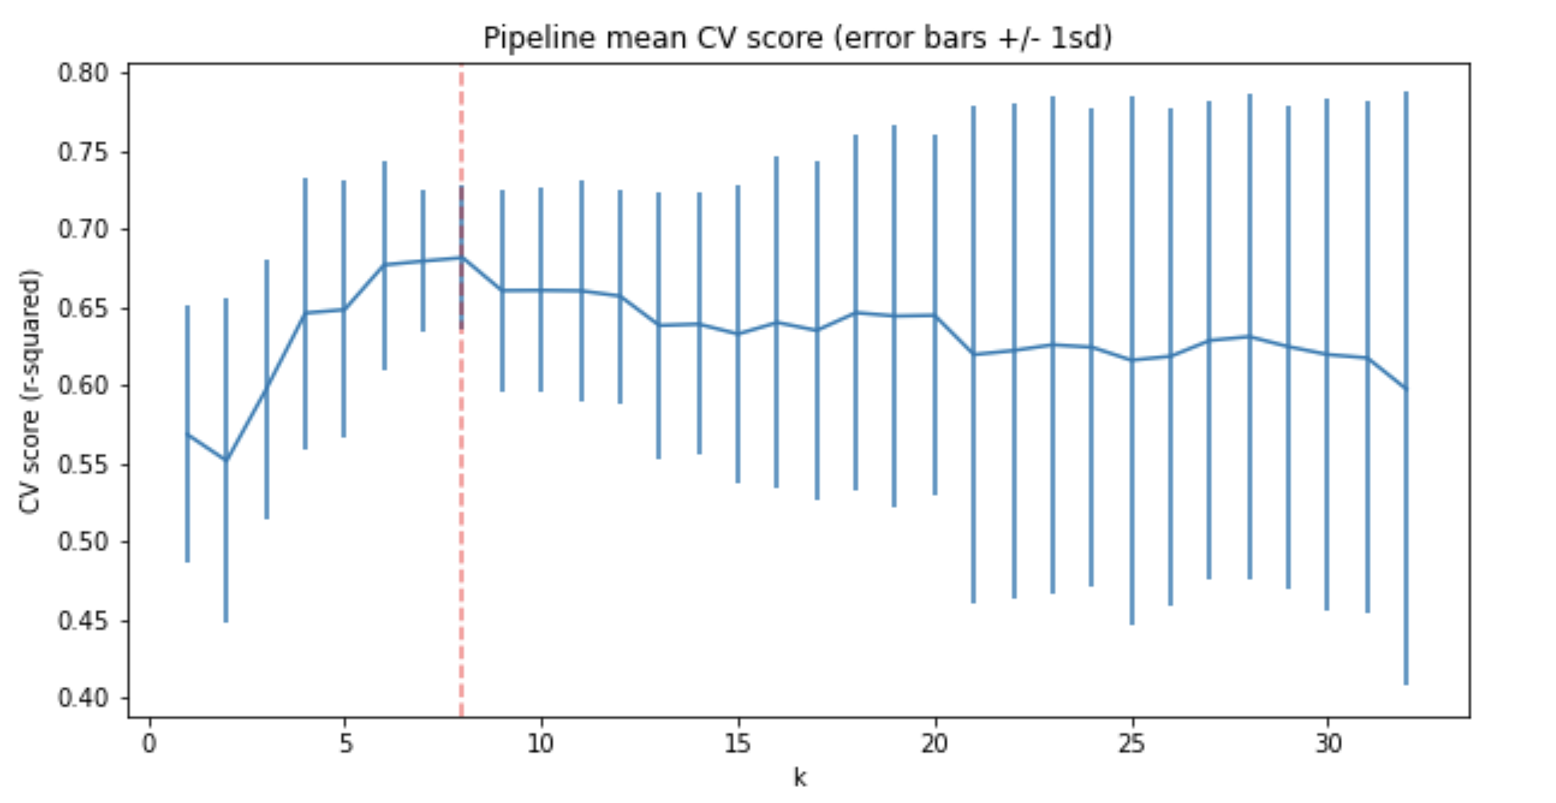
Optimizing for the number of features to model

Slide 8
In Conclusion
We were tasked with finding a more reasonable price for the Big Mountain Ski Lodge to stay competitive with the addition of their new ski lift. We were able to adjust the price of the ticket, and find some additional cost savings by making some recommendations about shutting down additional ski runs.

Slide 9
Problem identification (1-2 slides) (DONE)
Recommendation and key findings (1 slide) (DONE)
Modeling results and analysis (3-4 slides)
Summary and conclusion (1 slide) (Done)

